Slide 1


FOOD SAFETY TRAINING
757-314-8039
Notes:
Welcome to the new DHA PowerPoint template. Each slide contains helpful information for making the entire presentation user-friendly and accessible to people of all abilities. **Disclaimer** Additional remediation is required after you add content to this template to ensure 508 compliance.
Please note: if your presentation is being presented online, the PowerPoint file must be converted and remediated as a PDF.
There are two possible classification levels for most DHA presentations: Unclassified and Controlled Unclassified Information (CUI). Delete the classification level that does not apply to your presentation and leave the correct one. Don’t forget to delete the / too!

Slide 2

DISCLAIMER
NOTE:
*This course is intended for person(s) conducting ORGANIZATIONAL FOOD EVENTS that are open to the GENERAL PUBLIC on the installation and involve the preparation or sale of food subject to Time/Temperature Control for Safety (TCS).
* Food Safety DOES NOT fulfill the requirements of 4 hour initial/annual food safety training required of FOOD EMPLOYEES working in a FOOD ESTABLISHMENT
Notes:
Talking Points:

Slide 3
REFERENCE
TB MED 530 (Tri-Service Food Code)
Servesafe Manager. (from https://www.servsafe.com/ )
Centers for Disease Control and Prevention (CDC). (2018, November 5). Burden of foodborne illness: Overview.
Notes:
Talking Points:

Slide 4
TRAINING OUTLINE
Foodborne Illness Overview
Key Terms
Food Safety Hazards
Foodborne Illness Risk Factors
Layers of Protection
  Personal Hygiene
  Time/Temperature Control
  Proper Cleaning and Sanitizing
Quiz

Slide 5
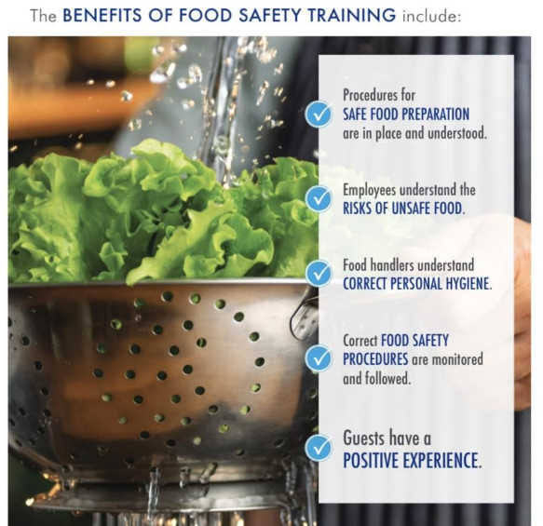
FOODBORNE ILLNESS OVERVIEW

Slide 6
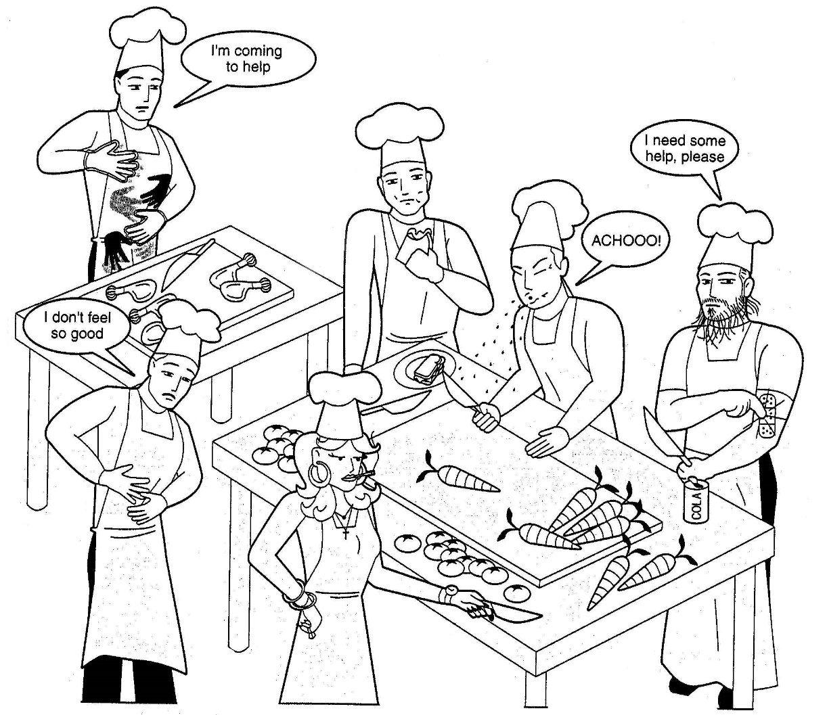
FOODBORNE ILLNESS OVERVIEW
What’s Wrong With This Picture?

Slide 7


FOODBORNE ILLNESS OVERVIEW
Something to think about?
CDC estimates that each year 1 in 6 Americans get sick from contaminated food or beverages and 3,000 die from foodborne illness
The U.S. Department of Agriculture (USDA) estimates that foodborne illnesses cost the United States more than $15.6 billion each year.

Slide 8
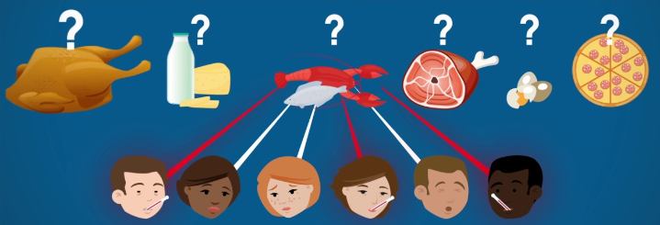
WHAT CONSITUTES AN OUTBREAK
Two or more people have the same symptoms after eating the same food
An investigation is conducted by state and local regulatory authorities
The outbreak is confirmed by laboratory analysis

Slide 9


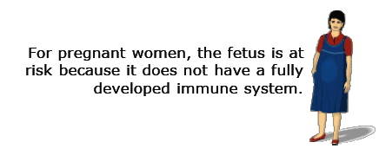
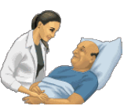

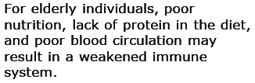

FOODBORNE ILLNESS OVERVIEW

Slide 10
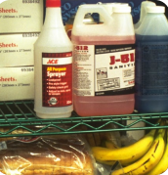
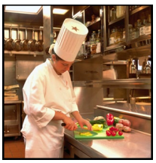
KEY TERMS
Cross-contamination - The transfer of a harmful substance to food through direct or indirect contact
  Spilled chemicals or detergents on food packages
  or surfaces where food comes into direct contact.
  Using unsanitized equipment or utensils to prepare, store, or serve food.
    Bare-hand contact with foods that are ready-to-eat (RTE).
    Bacteria from raw protein foods transferred to foods
    that are RTE.

Slide 11
KEY TERMS
Ready-to-eat (RTE) Food - A food that can be eaten without further
preparation, washing, or cooking. Examples include.
  Food that has already been cooked
  Washed fruits and vegetables (whole or chopped)
  Deli meat & cheese
  Bakery items
  Sugar, spices, and seasonings

Slide 12
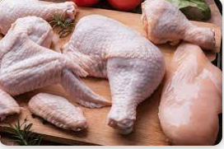
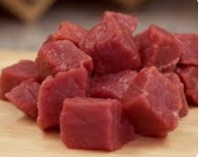
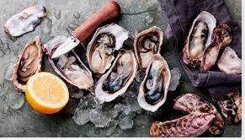
KEY TERMS
Time/Temperature Controlled for Safety (TCS) Food -
(Previously referred to as Potentially Hazardous Food) -
A food that requires time or temperature control to limit the growth of harmful micro-organisms or the formation of toxins.
The relationship between various factors will determine if a food requires time/temperature control for safety.
  pH of the food
  Water activity of the food
  Interaction between the pH and water activity
  Heat treatment of the food
  Packaging

Slide 13
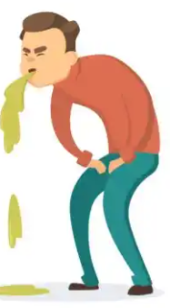
FOOD SAFETY HAZARDS
Microbiological hazards – Most critical
Chemical hazards
Physical hazards
Allergens

Slide 14
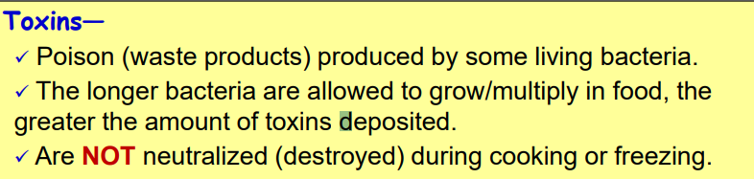
MICROBIOLOGICAL HAZARDS
The Nature of Bacteria
Bacteria are microscopic and cannot be seen by the naked eye.
  Hundreds or thousands of bacteria may already exist on raw foods when purchased.
The right temperature, moisture, and food are needed for bacteria to survive and multiply.
  Double in numbers every 15-30 minutes under ideal conditions.
Bacteria in food can cause:
  1. Infection - illness caused by ingesting enough live bacteria.
  2. Intoxication – illness caused by ingesting the toxic chemical residues deposited in food when the bacteria was alive

Slide 15
MICROBIOLOGICAL HAZARDS
Consist of the following: (Bacteria, Virus, Parasite and Fungi)
Bacteria
  Campylobacter
  A species of bacteria that is one of the most common causes of foodborne illness in the US (raw or undercooked poultry)
  Salmonella
    Salmonellosis
    Enteric fever
  Listeria
    Listeriosis is not common, it is one of the leading causes of death from foodborne illness
  E. coli
    Major bacteria species and can live in human intestines
Virus
  Norovirus
    Norovirus is the most common cause of illness from contaminated food or water
  Hepatitis A
    Contaminated water, shellfish, and salads are the foods most often linked to outbreaks

Slide 16
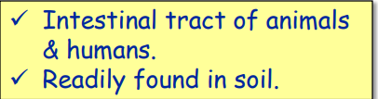

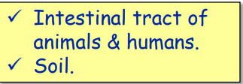

MICROBIOLOGICAL HAZARDS
Toxigenic Bacterial Pathogens
A. Infective bacteria that also produce a toxin-
  Escherichia coli 0157:H7 (E. coli O157:H7)
  Staphylococcus aureus
B. Spore-forming, toxigenic bacteria-
  Clostridium perfringens
  Clostridium botulinum
  Bacillus cereus

Slide 17
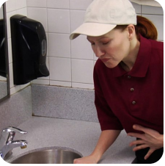
MICROBIOLOGICAL HAZARDS
Common symptoms of foodborne illness:
  Diarrhea
  Vomiting
  Fever
  Nausea
  Abdominal cramps
  Fatigue
Onset time:
  Depend on the type of foodborne illness
  Pre-formed toxins cause “upper GI” symptoms with onset of nausea/vomiting in 2-4 hours (higher amount of toxin, sooner the onset)
  Exposure just to pathogens may take much longer, up to 6 weeks

Slide 18
MICROBIOLOGICAL HAZARDS
Disclosure by Food Handlers-
Reportable symptoms:
  Vomiting
  Diarrhea
  Jaundice (yellowing of skin/eyes from liver disease)
  Sore throat with fever
  Infected wound or lesion with pus (oozing boils, cysts, or sores)
Those handling/serving food that HAVE any symptoms above MUST EXCLUDE themselves from serving or handling foods.

Slide 19
Chemical, Physical, and Allergens hazards
OTHER FOOD SAFETY HAZARDS
Chemical Hazards Physical Hazards Allergens
Detergents Pests Milk
Sanitizers Glass Eggs
Pesticides Plastic Crustacean Shellfish
Naturally occurring Toothpick Tree Nuts
fish or plant toxins Metal Soybeans
Medications False fingernails
Jewelry Bandages

Slide 20
FOODBORNE ILLNESS RISK FACTORS
There are 5 major risk factors linked to food handlers' behaviors and food preparation practices
  Poor personal hygiene
  Inadequate cooking
  Improper holding temperatures
  Contaminated equipment
  Food from unsafe sources
Factors controlled by
food handler

Slide 21
POOR PERSONAL HYGIENE
People are natural carriers of bacteria-
  Staph bacteria found on skin & hair, regardless of how often you bathe.
  Fecal-oral route of transmission -- Bacteria found in our intestines transferred by poor handwashing to what you touch, then eaten by someone else.
People can also carry harmful viruses that are readily transmitted through food or contact with surfaces that are touched by others.
  Norovirus
  Infection occurs when contaminated food is ingested or contaminated hands encounter mucous membranes(eyes, nose, mouth).

Slide 22
POOR PERSONAL HYGIENE
A large percentage of foodborne disease outbreaks are spread by contaminated hands.
Handwashing can reduce the risk of foodborne illness and other infections ~ CDC
Washing hands with soap and water could reduce deaths from diarrheal disease by up to 50%
People can contaminate food when-
  They don’t wash their hands after using the restroom.
  They come to work when they are sick or have been in contact with a person who is sick.
  They sneeze into their hands or onto food or food-contact surfaces.
  They touch dirty food-contact surfaces and equipment and then touch food.
Avoid personal behaviors that can contaminate food!

Slide 23
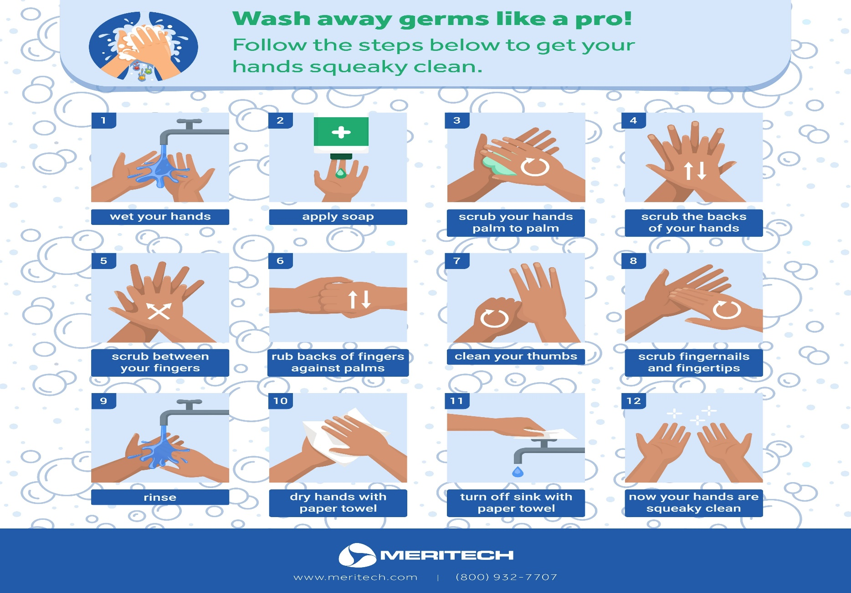

Slide 24

WHEN TO WASH HANDS
Before starting work
After using the restroom
After coughing, sneezing, smoking,
eating or drinking
After blowing or touching your nose
After touching face, hair, mouth, sores
After touching raw poultry, meat, fish
Between handling money or food
After touching dirty dishes, equipment,
and utensils
After touching trash, floors, soiled linens
After using cleaners or chemicals
Before handling single use items (i.e., cups, utensils, etc.)

Slide 25
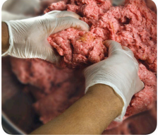
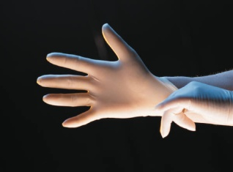
USING GLOVES PROPERLY
Always wash hands before putting on gloves and when changing to a fresh pair.
Wearing gloves:
  Wash and dry hands before putting on gloves.
  Select the correct glove size to ensure proper fit.
  Hold gloves by the edge when putting them on.
  NEVER blow into gloves
  NEVER roll gloves to make them easier to put on.
Change Gloves:
  When they become dirty or torn.
  Before starting a different task.
  After handling raw meat and before handling cooked or ready-to-eat foods.
Notes:
Note: Do not use powdered gloves.

Slide 26
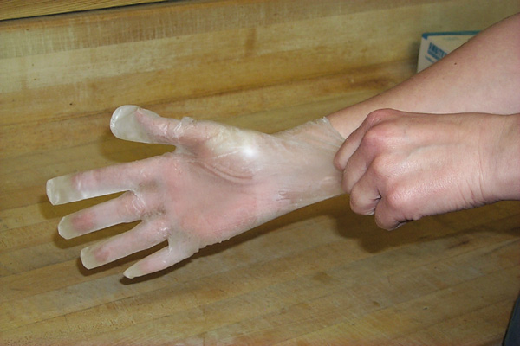
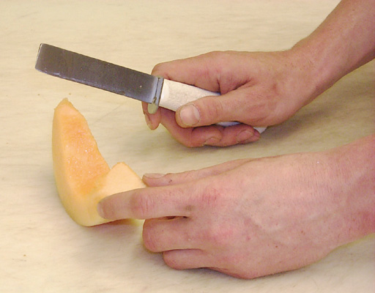
Minimize Bare-Hand Contact by Using Suitable Utensils
SUITABLE UTENSILS
Deli tissues
Spatulas
Tongs
Forks
Dispensing equipment
Single-Use Unpowdered gloves
Notes:
Discuss proper glove use. Change often.

Slide 27

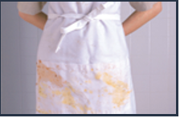

POOR PERSONAL HYGIENE
Clean Uniforms
  Wear clean uniform or clothing daily;
  Change outer clothing when it becomes heavily soiled with food
  debris during the day.
  Remove aprons when leaving food-preparation areas.
Jewelry
Remove jewelry and watches from hands and arms when preparing, cooking, or serving food.
Exceptions allow wearing:
  Single, plain/smooth ring/wedding band;
  Medical alert bracelet or necklace.

Slide 28
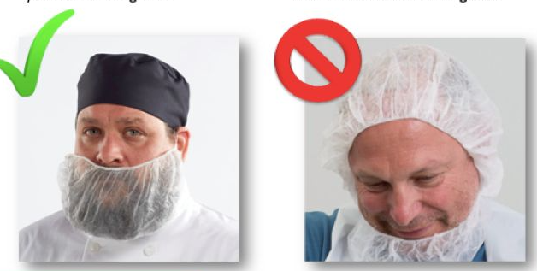
POOR PERSONAL HYGIENE
Hat/Hair Restraints
  Clean hat or hair net
  Paper/disposable hat
  Long hair must remain pinned or tied and tucked under hat
  Beard-net must be worn if hair exceeds ¼inch of face
Fingernails
  Short (recommend no more than ¼ inch above the fingertip)
  Neatly trimmed & smooth
  No false nails, polish, or nail jewelry/ornaments
  Wearing disposable gloves does NOT dismiss this requirement

Slide 29
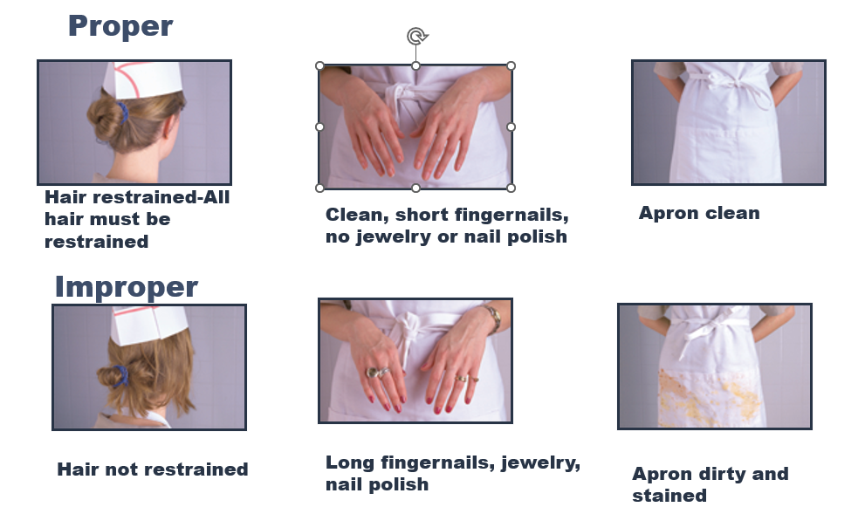
POOR PERSONAL HYGIENE

Slide 30
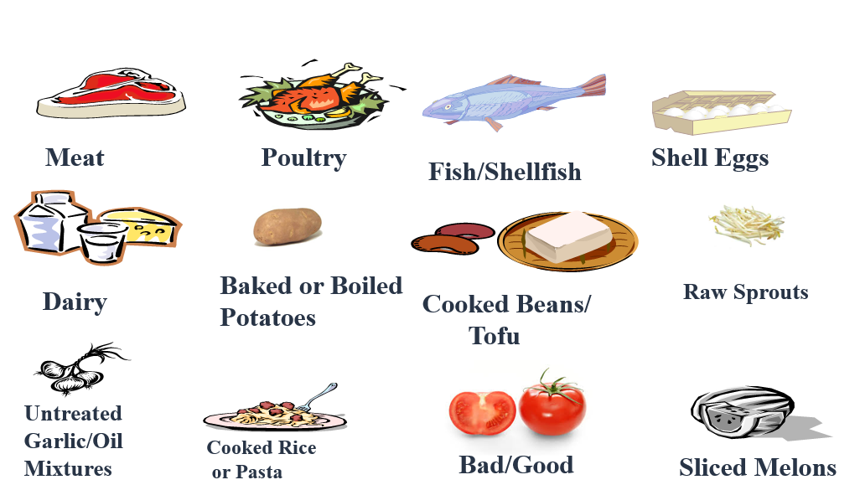
TIME & TEMPERATURE CONTROLS
There’s a correlation between the growth of bacteria and temperature.

Slide 31
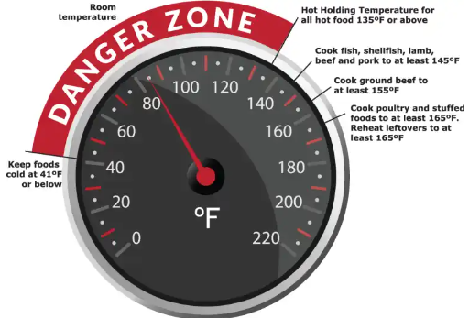
TIME & TEMPERATURE CONTROLS
Foods left in the temperature danger zone (TDZ) (42° F -134° F) too long. Time in the TDZ is cumulative. After 4 hours, the potentially hazardous foods must be discarded
Microbial growth needs FAT TOM ( Food, Acidity, Temperature, Time, Oxygen and Moisture)
After 4 hours, the potentially hazardous foods must be discarded
Inadequate re-heating of potentially hazardous foods. All leftovers intended to be served hot must be re-heated to 165° F within a 2-hour period

Slide 32
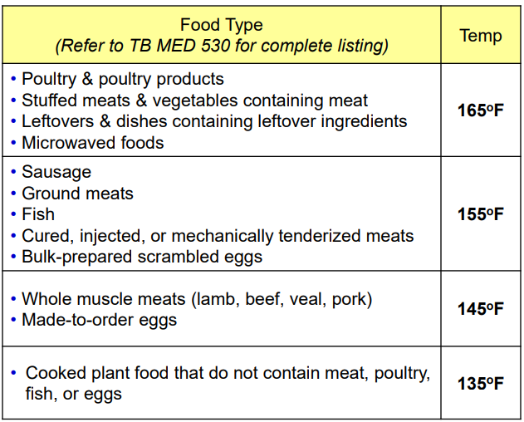
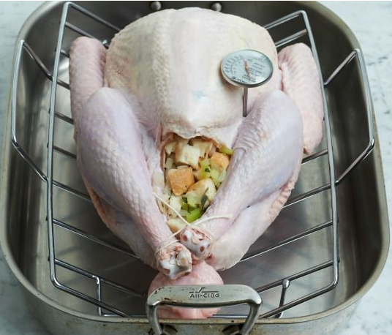
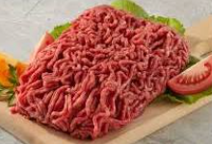
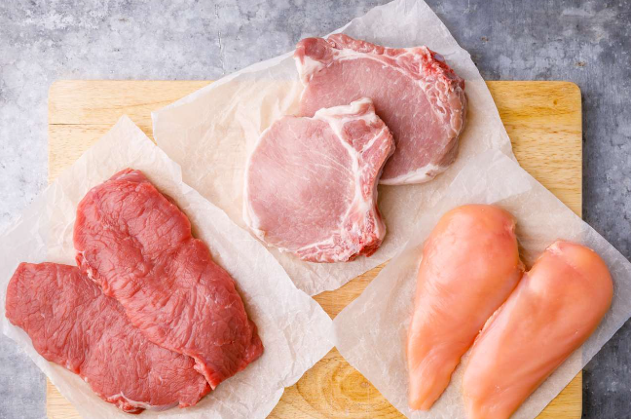
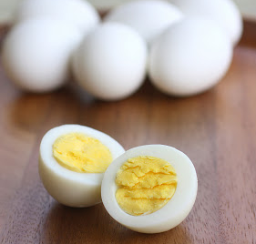
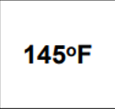
TEMPERATURE CONTROLS

Slide 33
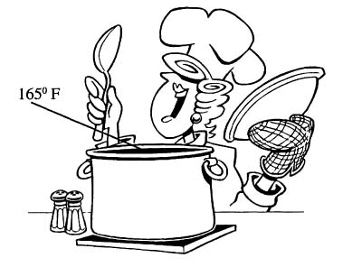
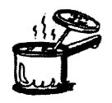
IS IT “DONE” YET?
Where is your food thermometer?
Using a food thermometer is the ONLY sure way of knowing if your food has reached a high enough temperature to destroy foodborne bacteria.

Slide 34
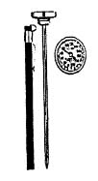
USING A FOOD THERMOMETER
Insert stem into thickest part of the food.
Hold for at least 15 sec. to read accurate temperature.
TIPS:
For thin meats, insert stem sideways at least two inches.
Keep the probe from touching the sides or bottom of the pan.
Always Wash, Rinse, Sanitize, and Air-Dry Thermometers Before and After Each Use!

Slide 35
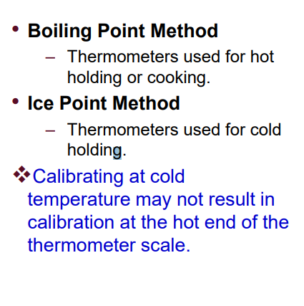
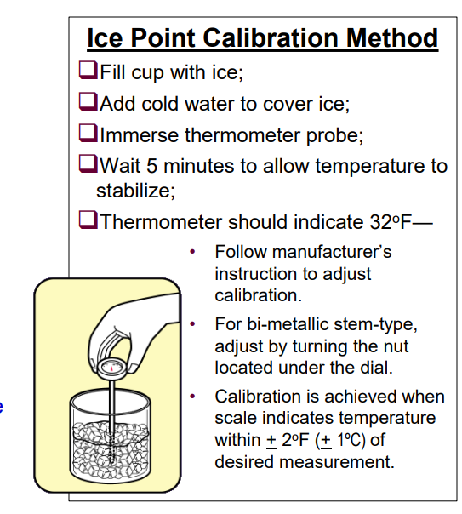
THERMOMETER CALIBRATION

Slide 36
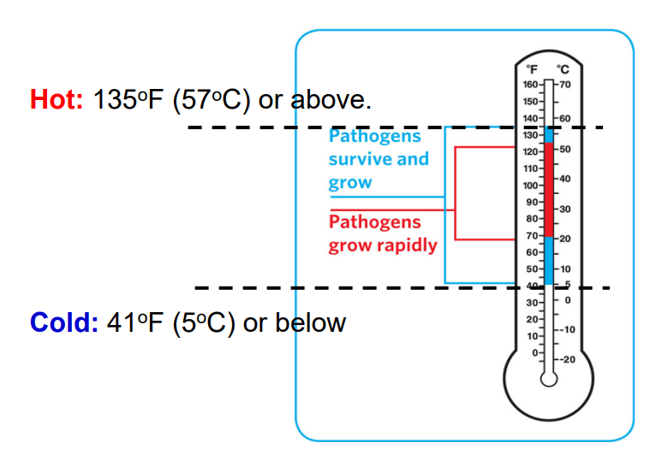
TEMPERATURE CONTROLS
Safe Holding Temperatures

Slide 37
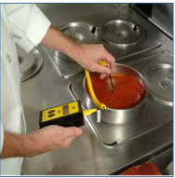
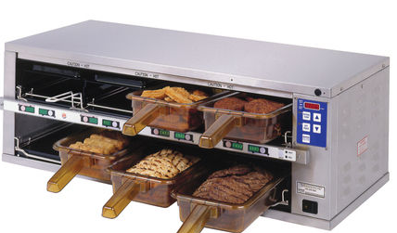
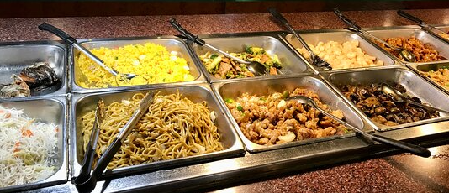
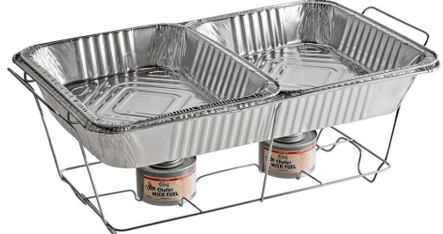
TEMPERATURE CONTROLS
Guideline for Holding Food
  Hold hot food at 135°F (57°C) or higher
  Hold cold food at 41°F (5°F) or lower
  Check temperatures at least every four hours
  Only use equipment that can keep it at the proper temperature
  Never use hot-holding equipment to reheat its designed for reheating
  Stir at regular intervals to distribute heat evenly.
  Label date & time food was removed from temperature control
  4-Hour rule.
    Discard after 4 hours if food is removed or not temperature controlled
    Used when hot holding unit is not available

Slide 38
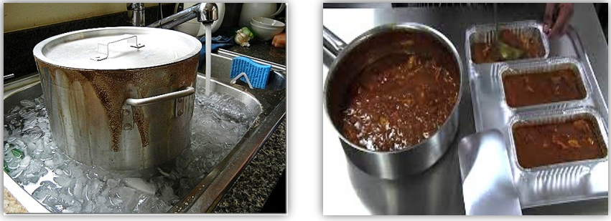
TEMPERATURE CONTROLS
Guideline for cooling food
  Ice bath (avoid food contact with ice)
  Use shallow containers or reduce quantity
  Cooked TCS food must be cooled within a total of 6 HOURS
    Within 2 HOURS from 135°F to 70°F
    Within 4 HOURS from 70°F to 41°F
  6-Hour rule: Used when cold holding unit is not available
    Initial internal temperature must be at 41ºF (5ºC)
    Internal temperature cannot exceed 70°F at anytime
    Labeling requirements same as 4-hour rule
    discard when food temperature reaches 70ºF or 6-hour point, whichever comes first.

Slide 39
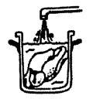
THAWING FROZEN FOOD
Refrigerator that maintains the
temperature at 41° F or lower
Microwave
(If will be cooked immediately)
Cooking
(As part of the cooking process)
Running Cool Water
(70° F or lower) Least
preferred method

Slide 40
CLEANING VS SANITIZING
Cleaning
Removes food particles.
Removes food stains.
Sanitizing
Reduces harmful germs to a
safe level.

Slide 41
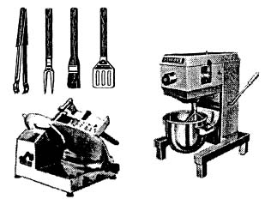
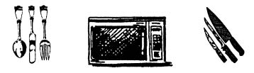
WHAT TO CLEAN AND SANITIZE
All Items - utensils, knives, plates, pans, etc.
All Food Contact Surfaces - meat slicers, cutting boards, prep
tables, can opener blade, etc.
All Non-Food Contact Surfaces - Refrigerators, stoves, ovens,
counters, shelves, drawers, etc.)

Slide 42
WHAT TO CLEAN AND SANITIZE
Always Wash, Rinse and Sanitize any surface that encounters food:
  Before and after food preparation, or during when you begin working with another type of food.
  At least every four hours if using something constantly.
  Mix sanitizing solution per the guide below to reach 100ppm sanitizing solution.

Slide 43
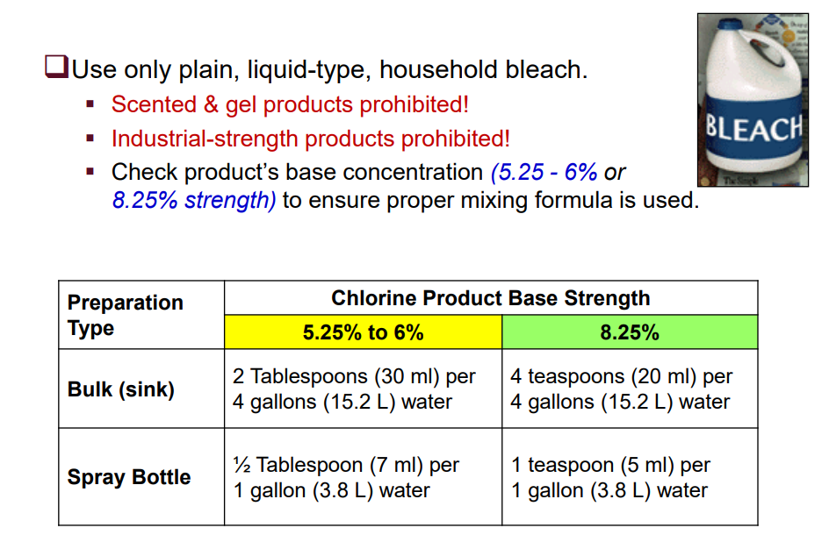
PREPARING SANITIZERS MANUALLY

Slide 44
CROSS CONTAMINATION
Store raw meat and poultry items in the refrigerator on a tray below foods that are ready-to-eat.
Use separate work areas for handling raw meat, fish or poultry items, away from foods that will be eaten uncooked.
Notes:
Embed: food storage and cross contamination video

Slide 45
METHODS TO AVOID CROSS CONTAMINATION
Remember to: Wash your hands often.
1
Properly clean and sanitize cutting boards and work surfaces.
2
Change your apron and gloves between tasks, especially after handling raw meat, and before handling cooked or ready-to-eat food.
3

Slide 46
PROHIBITED FOOD
Any food on hot or cold holding service line that goes into temperature danger zone (42-134) is not allowed to be retained as leftover.
Any buffet or self serve foods are not allowed to be retained and shall be discarded at end of meal. Such as salad items!
CDC’s and those who serve infants, elderly, or sick patients are also prohibited from having any leftovers.

Slide 47
BENEFITS OF FOOD SAFETY
Unit cohesion
Instill trust on food related events
Good reputation
Legal compliance – no criminal prosecutions or civil
lawsuits
Pleasant working environment
Healthy employees

Slide 48
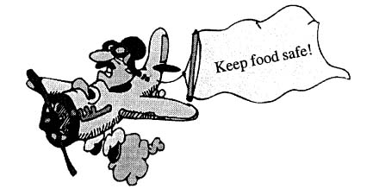
SUMMARY
Practice good personal hygiene.
Learn to use food thermometers.
Know temperatures for handling food.
Keep hot food HOT and cold food COLD!
Limit time spent in the temp. danger zone.
(42° F. to 134° F.)
Properly clean and sanitize to prevent contamination.

Slide 49
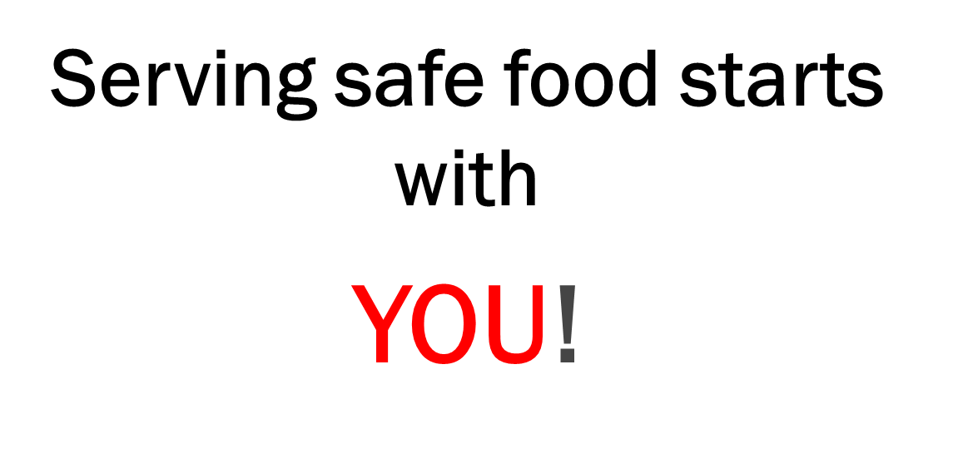
REMEMBER

